Slide 1

v
DevOps
Suresh
May 10, 2022

Slide 2
Contents
What is DevOps?
DevOps Stages
What are CI / CD
Continuous Integration
Continuous Delivery
Continuous Deployment
Advantages

Slide 3
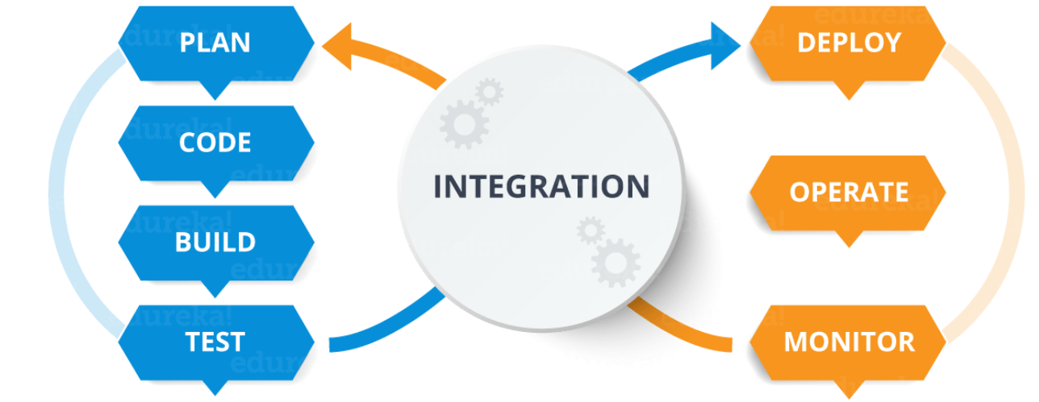
What is DevOps?
DevOps is a software development approach, which involves continuous development, continuous testing, continuous integration, continuous deployment and continuous monitoring of the complete software throughout this complete development lifecycle

Slide 4
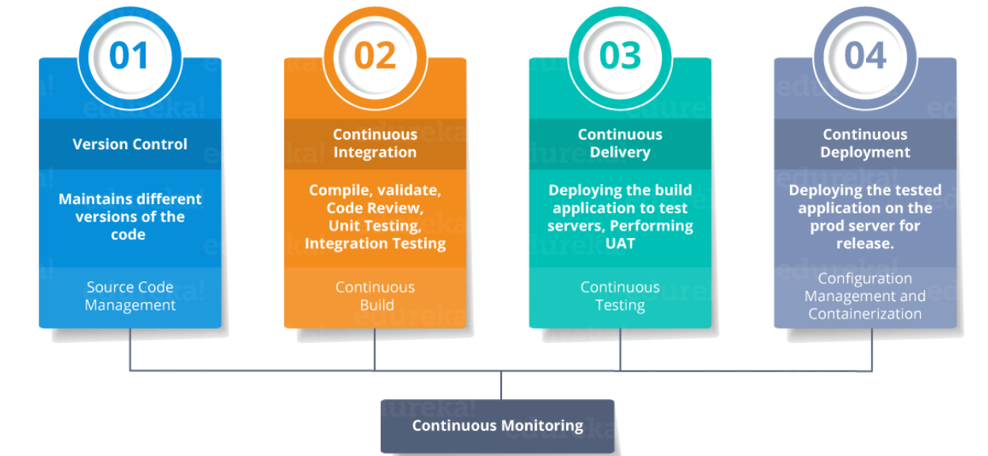
DevOps Stages

Slide 5
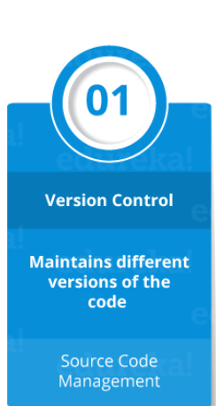
Version Control
Version control maintains the code. Version control is a system that records changes to a file or set of files over time so that you can recall specific versions later.
Notes:
Using a VCS also generally means that if you screw things up or lose files, you can easily recover.

Slide 6
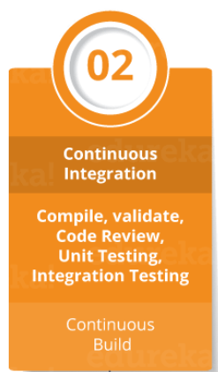
Continuous Integration
Continuous integration (CI) is the practice of automating the integration of code changes from multiple contributors into a single software project.
Notes:
Developers practicing continuous integration merge their changes back to the main branch as often as possible. The developer's changes are validated by creating a build and running automated tests against the build. By doing so, you avoid integration challenges that can happen when waiting for release day to merge changes into the release branch.
Continuous integration puts a great emphasis on testing automation to check that the application is not broken whenever new commits are integrated into the main branch.

Slide 7
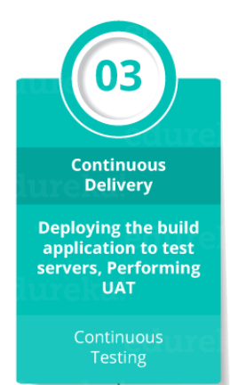
Continuous Delivery
Continuous delivery is an extension of continuous integration since it automatically deploys all code changes to a testing and/or production environment after the build stage.
This means that on top of automated testing, you have an automated release process and you can deploy your application any time by clicking a button.
Notes:
In theory, with continuous delivery, you can decide to release daily, weekly, fortnightly, or whatever suits your business requirements. However, if you truly want to get the benefits of continuous delivery, you should deploy to production as early as possible to make sure that you release small batches that are easy to troubleshoot in case of a problem.

Slide 8
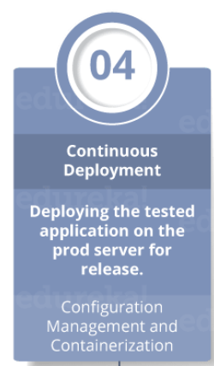
Continuous Deployment
Continuous deployment goes one step further than continuous delivery. With this practice, every change that passes all stages of your production pipeline is released to your customers.
Notes:
Continuous deployment is an excellent way to accelerate the feedback loop with your customers and take pressure off the team as there isn't a Release Day anymore. Developers can focus on building software, and they see their work go live minutes after they've finished working on it.

Slide 9
What is CI and CD
CI and CD are two acronyms frequently used in modern development practices and DevOps. CI stands for continuous integration, a fundamental DevOps best practice where developers frequently merge code changes into a central repository where automated builds and tests run. But CD can either mean continuous delivery or continuous deployment.

Slide 10
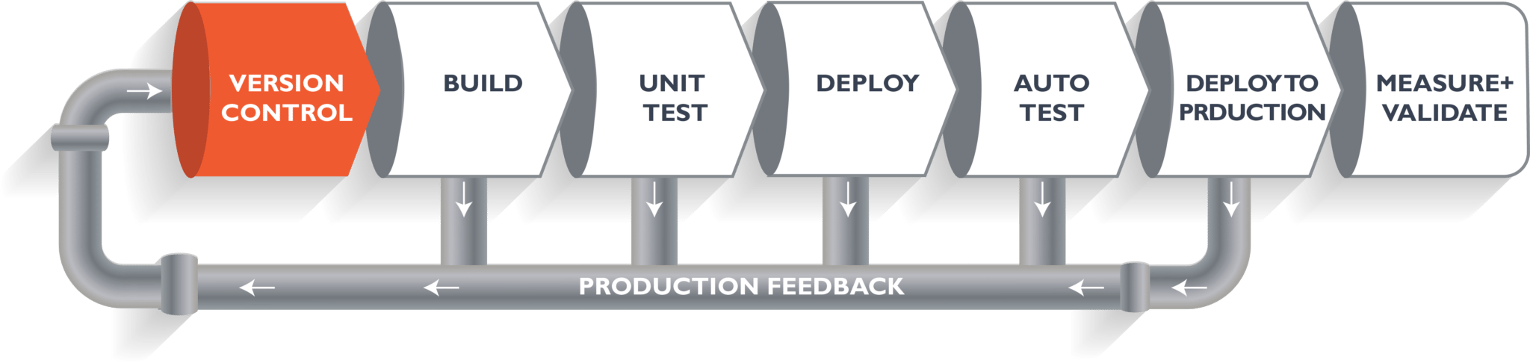
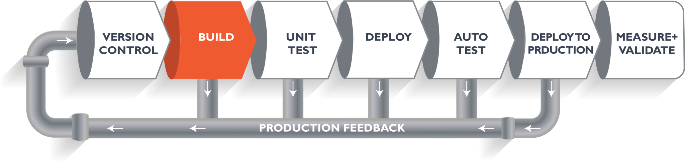
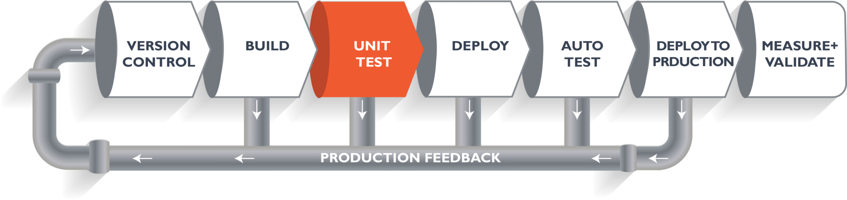
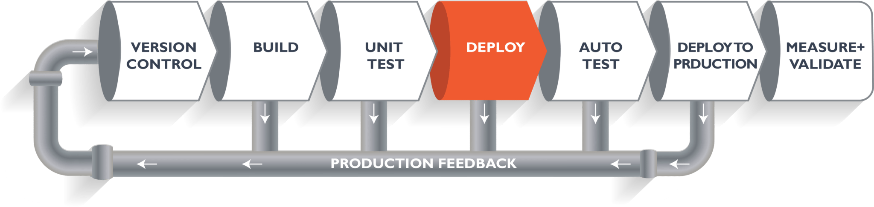
Let’s see how it works

Slide 11
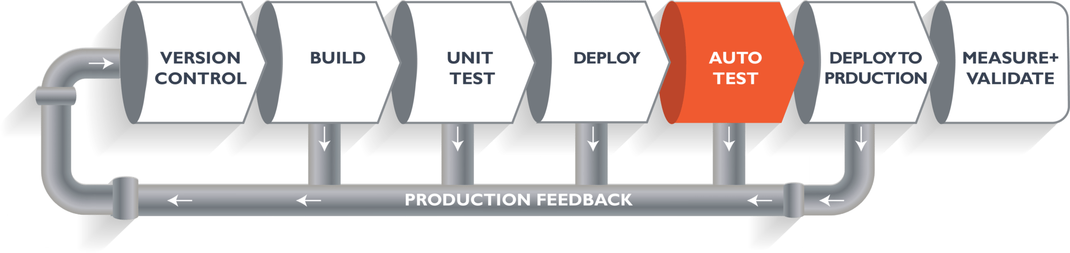
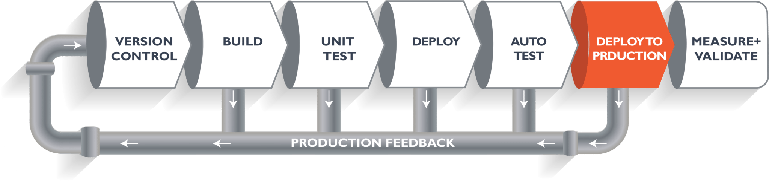
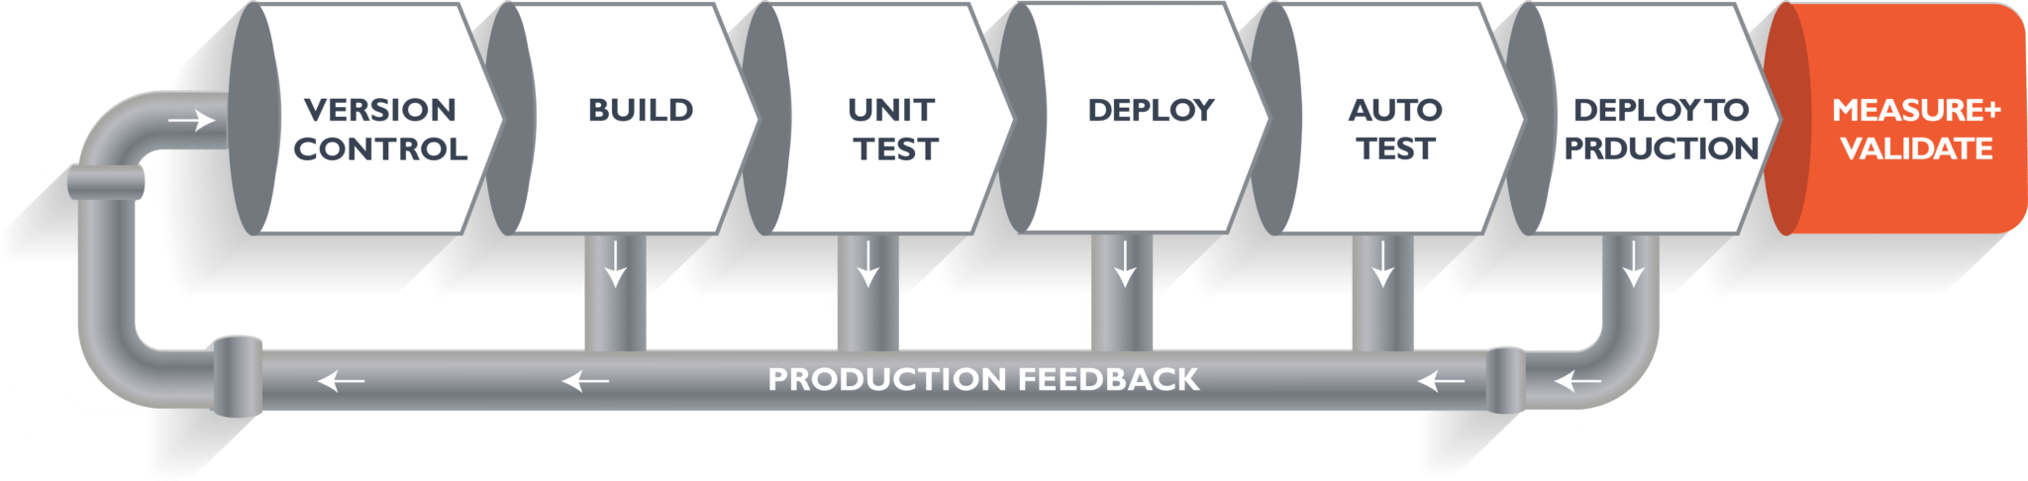
Let’s see how it works

Slide 12
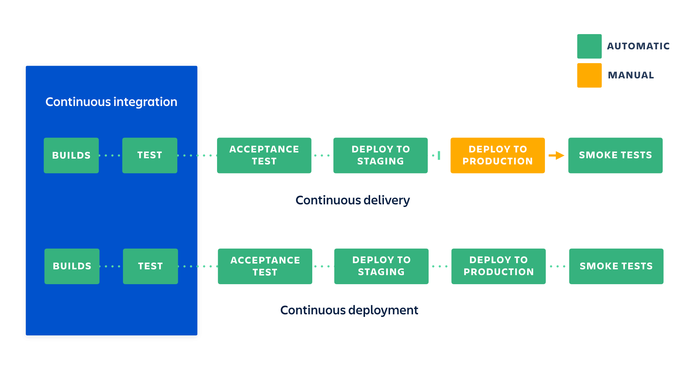
How they are related
Notes:
To put it simply continuous integration is part of both continuous delivery and continuous deployment. And continuous deployment is like continuous delivery, except that releases happen automatically.

Slide 13
Advantages
Building the release is easy as all integration issues have been solved early.
Testing costs are reduced drastically – your CI server can run hundreds of tests in the matter of seconds.
Your QA team spend less time testing and can focus on significant improvements to the quality culture.
Customers see a continuous stream of improvements, and quality increases every day, instead of every month, quarter or year.

